Slide 1
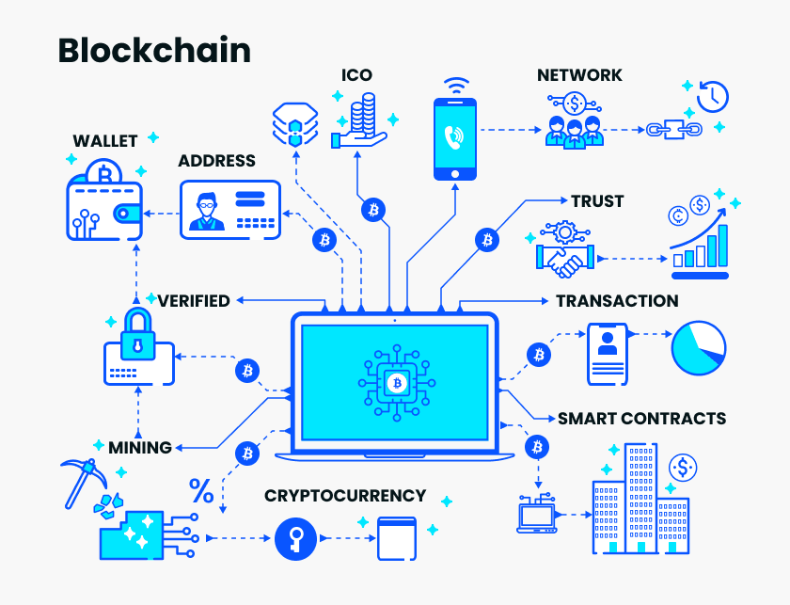
* Blockchain technology has gained a lot of interest due to its potential to change businesses, including digital currencies. * However, investing in digital currencies is risky due to their volatility, which can lead to price swings that cause significant losses. * Digital currencies are also vulnerable to cybercrime, which can result in the theft of assets. * Despite these risks, many still believe in the potential of blockchain technology to transform various industries.
"The Risks and Rewards of
Investing in Digital Currencies
and Blockchain Technology"
Chain but not always chain!

Slide 2

Cryptocurrency investment can be risky?
Digital currency investment risks:
Hacking: Price fluctuations:
Cryptocurrency scammers.
Cryptocurrencies are unreliable. Fake supplier emails are now used to steal funds. It pollutes CO2. harming the environment.
Threats Example: On August 11, 2021, digital currency was stolen at its largest. Hackers stole 800 million in virtual money from Poly Network's blockchain - based. Ether, binary, and USDC tokens total 286 million.

Slide 3
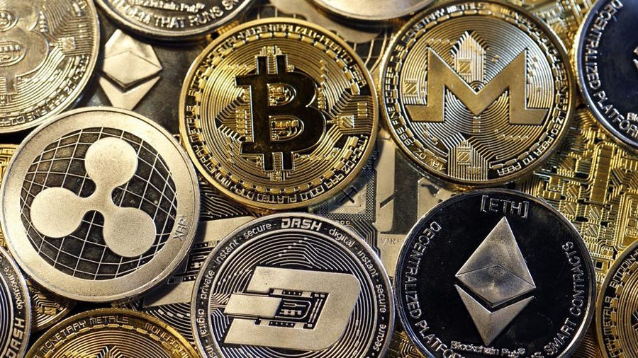
A viewpoint on blockchain
Future applications of blockchain technology:
Sectors of Banking and Insurance
Security in the Digital Age
Health
Information Management and Information Technology
Education
Keeping and transferring data
The Government's Strategy
Investigative Bureau

Slide 4

Important information before investing in cryptocurrencies
Recently, blockchain technology's corporate transformation potential has garnered attention. Blockchain technology may create a decentralized ledger that records and validates transactions, impacting digital currency. Digital currencies are dangerous due to volatility, cyberattacks, and fraud. Blockchain technology may alter enterprises, despite these risks.
Put a little money into it.
investing as little as possible.
Follow the appropriate forums, communities, and news sources to stay informed.
Pick a trustworthy cryptocurrency exchange like Zeb Pay.
Legal and market dangers are always present when investing in cryptocurrencies.
Be prepared to take a risk.
Reference:
My own project report (Attached)
Prepared By:
Abdullah Hill Hussain
MSIT
Washington University of Science & Technology

